Slide 1
Testing Hypotheses
p ≤ α

Slide 2




Slide 3


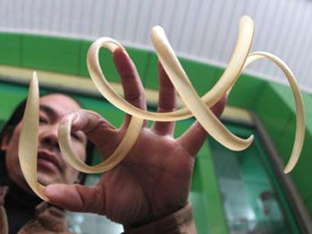
Are these fingernail lengths extreme?

Slide 4
Testing Hypotheses
Hypotheses and Testing Philosophies
Introducing the Frequentist P-Value
Test Statistics and All That
You’re Doing it Wrong (or are you?)

Slide 5
What is a Hypothesis? (in a statistical sense)
Point: Mean Fingernail Length == 5cm
Model: If I increase Kelp, Biodiversity increases
Explanatory: Fertilizers explain more variation in the data than Pesticides

Slide 6
Three Flavors of Statistical Inference
Frequentist: What’s the chance we observed something like the data given our hypothesis?
Likelihoodist: What’s the likelihood of our hypothesis relative to others?
Bayesian: How much do we believe our hypothesis given our data?

Slide 7
Frequentist Inference: the probability of observing this data, or more extreme data, given that a hypothesis is true
P-value
or
Confidence Interval

Slide 8
Our Hypothesis
‘Extreme’ fingernail lengths are not different from standard fingernail lengths

Slide 9
Testing Hypotheses
Hypotheses and Testing Philosophies
Introducing the Frequentist P-Value
Test Statistics and All That
You’re Doing it Wrong (or are you)

Slide 10
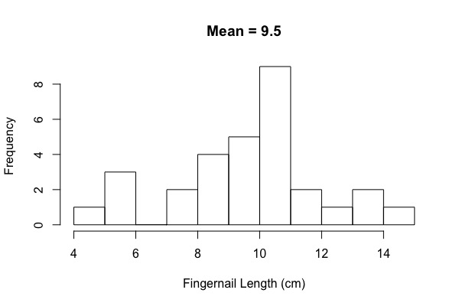
Our Sample

Slide 11
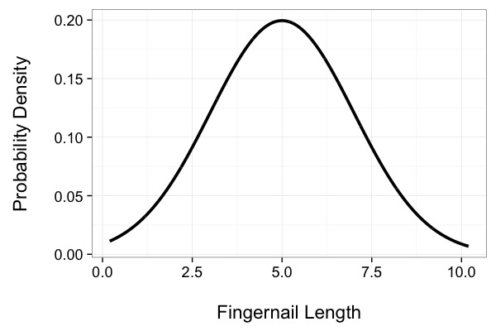
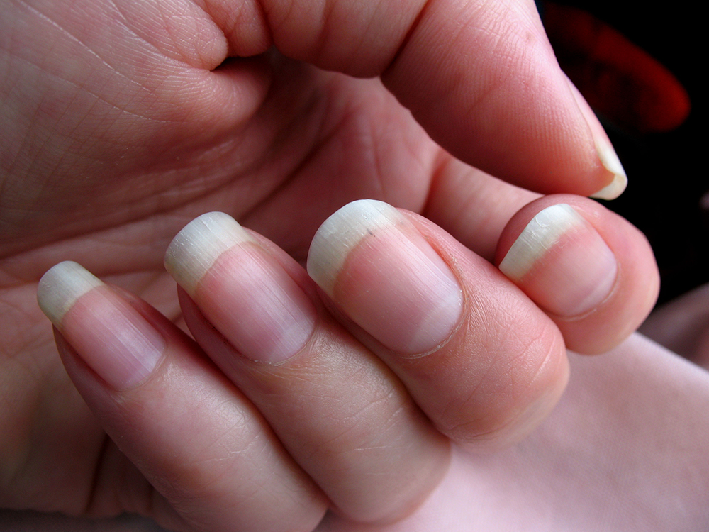
Assume a Distribution of Fingernail Sizes
Mean = 5
Standard Dev = 2

Slide 12
Our Hypothesis
‘Extreme’ fingernail lengths are from a distribution with mean of 5 and SD of 2.

Slide 13
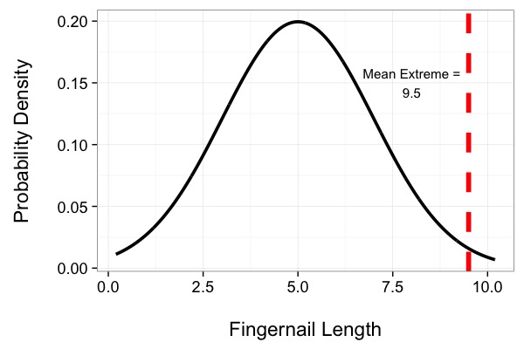
Is our size extreme?

Slide 14
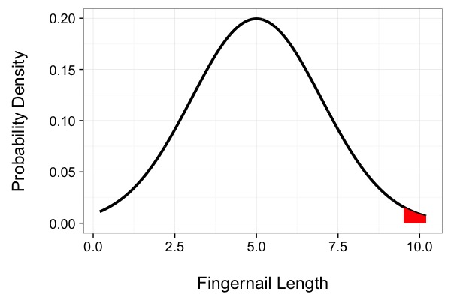
What about even more extreme values?
1.2% of the distribution
p = 0.012

Slide 15
Extreeeeeme!

Slide 16
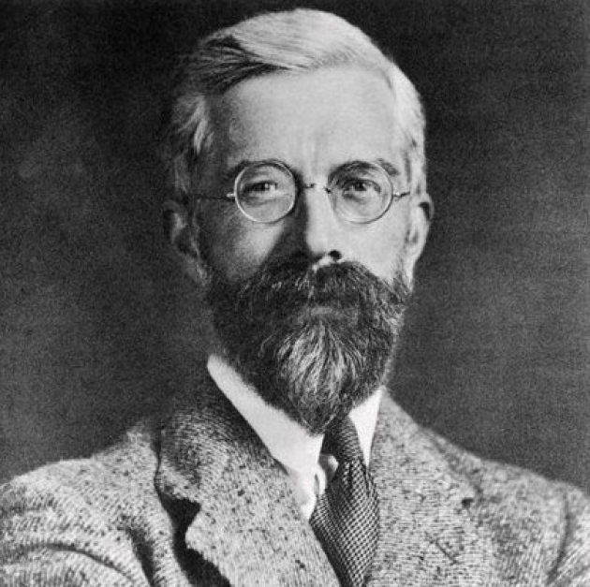
P-Values: Fisher
The probability of observing a value or more extreme value given a specified hypothesis.
R.A. Fisher

Slide 17
Testing Hypotheses
Hypotheses and Testing Philosophies
Introducing the Frequentist P-Value
Test Statistics and All That
You’re Doing it Wrong (or are you)

Slide 18
Null Hypothesis Testing
Frequentist testing of whether something is different from a null expectation
Example uses:
An estimate is not different from 0
The difference between two groups is not different from zero
A predictor provides no additional explanation of patterns in the data

Slide 19
Test Statistics: Making the World Sensible (and Null)
Create a null distribution
Use your data to calculate a test score
Calculate the p-value for your data in the context of that null distribution
P(D|H₀):

Slide 20
Testing Fingernails Against a Normal
H₀ = Mean of sample is not different from the rest of the population
Assume a normal distribution with an SD of 2
Calculate the difference between the mean of our sample and 5 = 4.5
Assess the p-value of 4.5 against the normal distribution with mean 0

Slide 21
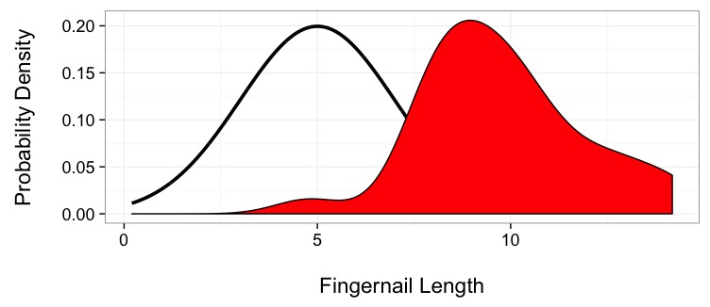
But…this is my data
Population of Fingernails
Measured ‘extreme’ fingernails

Slide 22
The Arrival of a Test Statistic
H₀ = Mean of sample is not different from the rest of the population
Assume a normal distribution with an SD of 1 (standard normal curve)
Calculate the difference between the mean of our sample and 5 = 4.5
Divide by the Standard Deviation of the population and the square root of the sample size (assumed SE of a population Sample) – z score!

Slide 23
Z-Score
z = 4.5 / (2/sqrt(30))
= 12.32
p(12.32|μ=0) < 0.0001

Slide 24
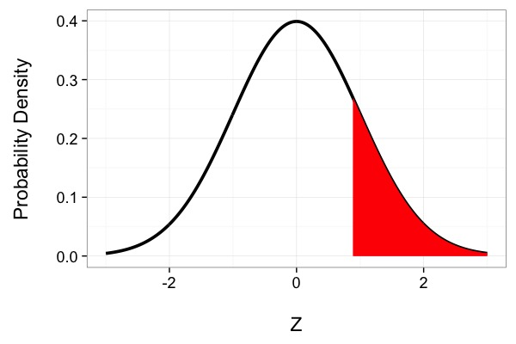
Z-Test

Slide 25
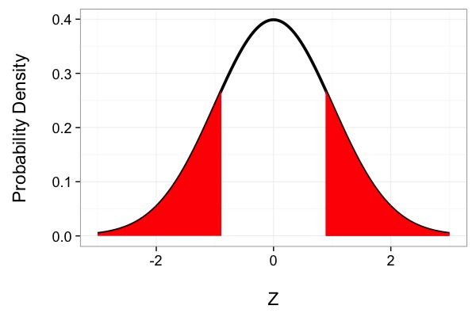
There Are Two Tails

Slide 26
Yes. These are super odd.

Slide 27
What do you do with a p-value?
P-values give the evidence for the probability of your data, or more extreme data, given a hypothesis
As the scientist, you decide whether it is grounds for rejecting a hypothesis
In a frequentist framework, you can only reject a hypothesis – never `accept`

Slide 28
Testing Hypotheses
Hypotheses and Testing Philosophies
Introducing the Frequentist P-Value
Test Statistics and All That
You’re Doing it Wrong (or are you)

Slide 29
How We Can Screw This Up
 | Is the Hypothesis True or False?
 |  | True | False
Test Result Against Hypothesis | Hypothesis Not Rejected | ☺ | Type I error
 | Hypothesis Rejected | Type II error | ☺
Probability of a type I error = α
Probability of a type II error = β

Slide 30
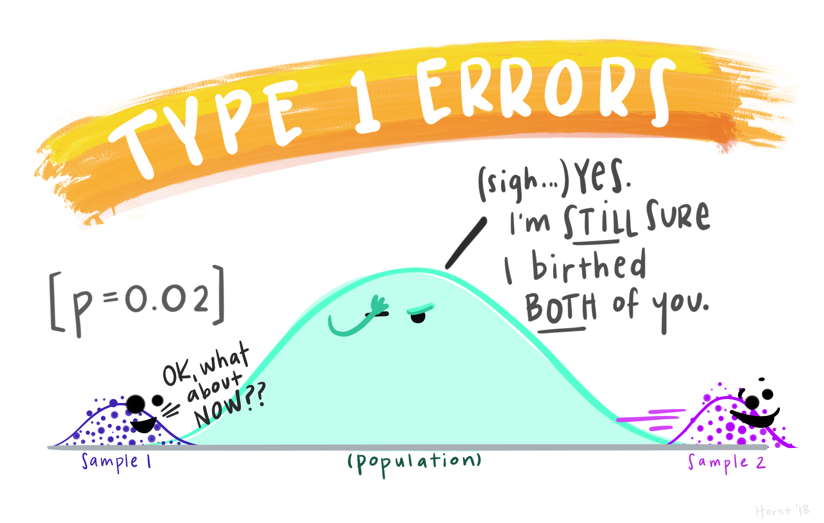
© Allison Horst, Stats and R Goddess, https://github.com/allisonhorst/stats-illustrations/

Slide 31
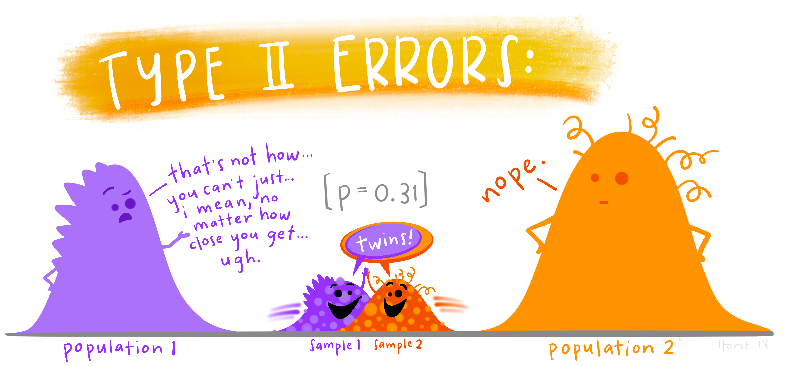
© Allison Horst, Stats and R Goddess, https://github.com/allisonhorst/stats-illustrations/

Slide 32

Null Hypothesis Significance Testing
Egon Pearson
Jerzy Neyman
Problem: What is an acceptable α?
Answer: 0.05. You have a 1 in 20 chance of committing a type I error

Slide 33
Problems with NHST
A realistic alpha can depend on your study design
E.g., Large sample size = lower p value
Ignores β
Tradeoff between α and β
Conflation of scientific significance and statistical significance
File-drawer effect
We are human
If p ≤ 0.05 makes your career, you will do a lot to obtain it!

Slide 34
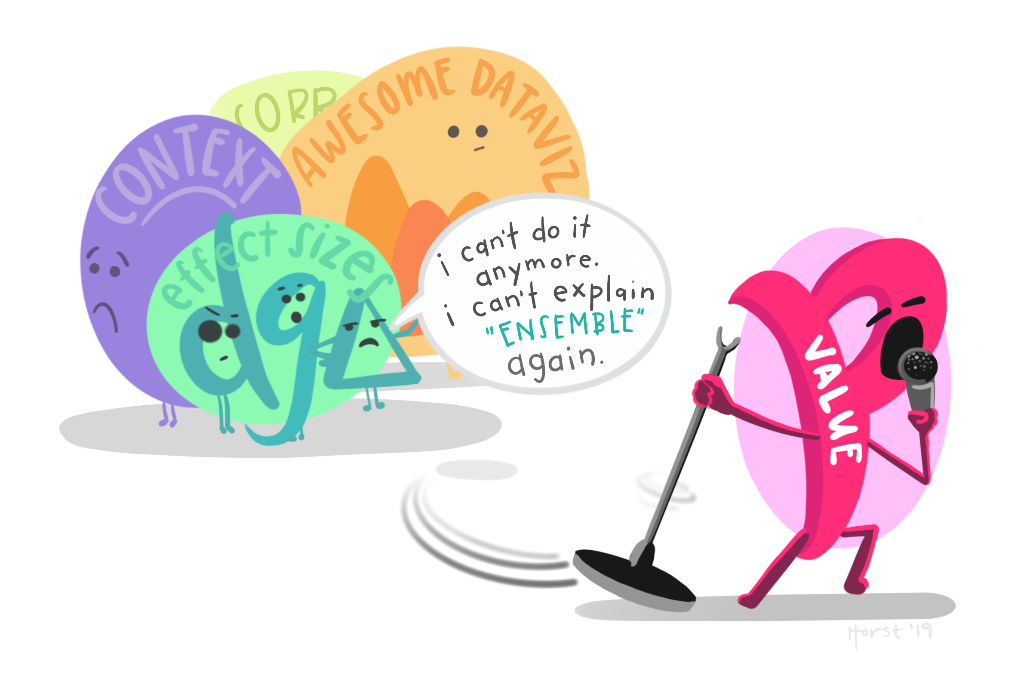
© Allison Horst, Stats and R Goddess, https://github.com/allisonhorst/stats-illustrations/

